Slide 1
August 22nd Meeting
Ainsley Lai

Slide 2
Agenda
Overview and Explanation of Source Level Models from Literature
Taken from Liefvendahl et al on the SHEBA project measuring merchant ship noise in the Baltic Sea where they use broadband data
Models use frequency as main input into source level functions with little variation in how ship speed is used

Slide 3


Models
Ross Model
RANDI Model
Wales-Heitmeyer model
SONIC Model
Wittekind Model
Equations for Source Spectrum Level in dB
(Responsible for coloring of previous spectrograms?)

Slide 4


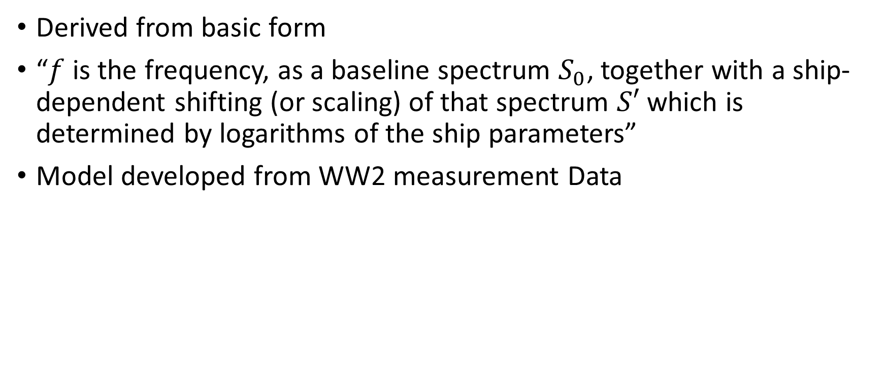
Ross Model
Derived from basic form
“$f$ is the frequency, as a baseline spectrum $S_{0}$, together with a ship-dependent shifting (or scaling) of that spectrum $S′$ which is determined by logarithms of the ship parameters”
Model developed from WW2 measurement Data

Slide 5


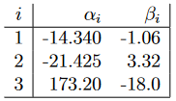



RANDI Model
Adaptation/Extension of Ross model
Consists of base spectrum and ship parameter-based scaling terms like in Ross model but adds a correction term, $S′′$, for low frequencies

Slide 6

Wales-Heitmeyer model
“The model is based on statistical analysis of noise measurements for a large number of merchant ships in transit”

Slide 7
SONIC Model
Combines the Wales-Heitmeyer ensemble spectrum model (used as a base spectrum) with the velocity-based scaling term from the Ross model. Adds a constant off-set value of 8 dB.
Parameter scaling term from Ross Model

Slide 8


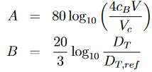


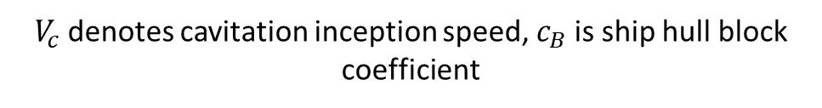
Wittekind Model
Models 3 different contributions to source level using larger # of params. Terms model low-freq. cavitation, high-freq. cavitation, and diesel engine noise, in that order.
“expressions are given for the source 1/3-octave band levels (instead of for the source spectrum level, as in the previous [models]“
$V_{c}$denotes cavitation inception speed, $c_{B}$is ship hull block coefficient
Where m=engine mass, n=# of engines, E=constant corresponding to engine mounting

